Slide 1
SQL and NoSQL
David Cosman CS4411B FW16
mongoDb – An Agile Solution to Changing Information

Slide 2
Table of Contents
Focus of presentation
SQL vs NoSQL
Sequential Query Language vs “Not only” or “Non relational” SQL
Why NoSQL?
History of Data: predecessors to databases
MongoDB
To SQL or NoSQL: Further work

Slide 3
Focus: What will this presentation cover?
What drives the mix of Relational and NoSQL?
Where does the need for flexible data come from?
When did data start changing for NoSQL to be necessary?
If we answer these questions, we can better understand the agile approach to database implementation

Slide 4
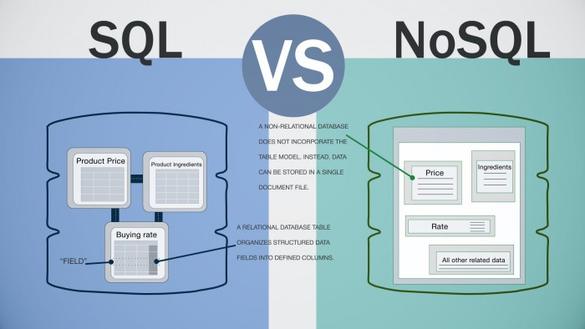
Why NoSQL?
Notes:
The Relational Model is more reliable for storage and query time because of its organization providing a structure
NoSQL trades those constraints with flexibility of data objects
So why NoSQL?

Slide 5
Issues with SQL
Time to start;
the “birth of Schema” problem
Structure is difficult to change once it exists
Schema must be modified to accommodate updates
Scalability of data difficult to maintain as a result
Unless data remains in static structure

Slide 6
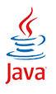

SQL & NoSQL: A Programming Language Comparison
Java
You must define objects, variables, and classes before using them
Reliable rules, checked during compilation for runtime errors
Data concurrency in place
Ruby
Objects can be “mixin” between classes and modules with no prior definition (interpreted part)
Unreliable testing in concurrent environments, difficult to debug as a result
Quick to use at the cost of reliability and performance

Slide 7
SQL & NoSQL: A Programming Language Comparison
SQL is like Java in a way, enforcing some sort of schema,
But enforces the creation of the structure first
NoSQL is like Ruby in a way; quick to implement, write and use,
But comes at the price of losing structure and concurrency
In general, NoSQL is good at inserting, but not good at retrieving

Slide 8
Some NoSQL considerations - Data Changes
SQL schemas don’t allow for much flexibility nor scalability
despite advantages with reliability and consistency
Always room for change in structure
Will your schema evolve over time?
Will the same attribute vary in type from entity to entity?
Can you foresee decisions that will be made with the data?
The drive for NoSQL databases is to accommodate growing or expanding databases
Let’s look back; has data always been static?

Slide 9



From the Note to the Computer
The ways we interact with data, the way which it’s stored; it’s always been changing, and keeps changing rapidly!

Slide 10
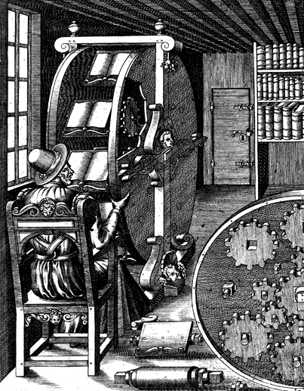
The Book: History of databases before computers
The Book Wheel
16th Century illustration by Agostino Ramelli
Function: to perform a JOIN and then a SELECT
Book shelves; a primitive database, a place to store records
The book wheel can be seen as predecessor of databases and e-book devices

Slide 11
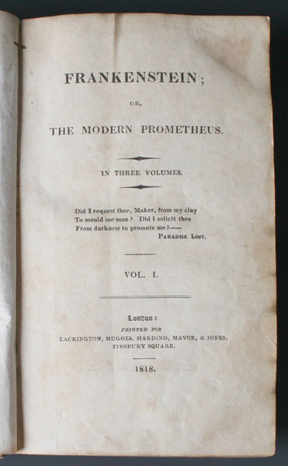
18th Century - Different Data
The first page of the first edition of Frankenstein, by Mary Godwin-Shelly
Only year included, no specific date.
No ISBN
No bar code
No author!!!

Slide 12
Information is still changing – not Constant
A need for a Database model that doesn’t enforce a schema
The Schema limits the complexity of the data
Makes it difficult to change the model

Slide 13
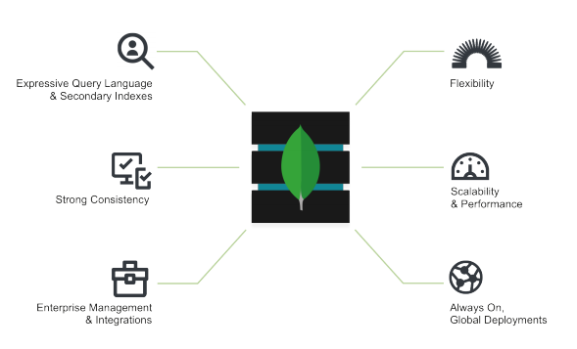
MongoDB Multimodel Architecture
Largely NoSQL
Easy to add new features and records
Uses a dynamic schema that adapts to the data
Scalable for growing applications
Still mixes some RE
Expressive Query Language
Strong data consistency across devices

Slide 14
MongoDB – How does it store data?
Data stored as documents
Uses BSON (Binary JSON) to store data as binary representation
Data strings split into series of bytes
Data is divided by non-terminal specifiers. For example,
\x03 e_name document
represents an embedded document
e_name ::= cstring
represents a key name
Using BSON, MongoDB can run fast searches without defining a schema for the data model.

Slide 15
MongoDB – Data storage continued
Documents sharing a similar structure are merged into collections
Avoids using a JOIN operation to get related data between tables
However, outer-left JOINs can be used to combine collections
Unlike NoSQL
MongoDB provides the choice of user enforced checks on
Document Object Model
Data Types, ranges and mandatory fields
Not limited to key value operations thanks to BSON storage

Slide 16
To SQL or NoSQL
MongoDB is faster for starting an application
Easy to begin adding data; no need for schema
Scalable for big companies with evolving data
Faster for selection queries with various numbers of records
But choice of database is situation dependent
There is no “perfect” database model

Slide 17
Further Research
Apply the Flexible Schema design provided by MongoDB
Will create a blogging web application with MEAN stack
Investigate comparisons between MySQL and MongoDB
Both open source
Performance
Syntax
Design philosophy – why did they make the choices they made?
How do they mix?

Slide 18
Questions?
Thank you for listening!

Slide 19
References
MongoDB Architecture Guide (2016) www.mongodb.com
Liu, Hammerschmidt, Lu, Chang; “Closing the functional and Performance Gap between SQL and NoSQL.” SIGMOD, San Francisco, 2016

